Slide 1
Introduction to Neural Network
Abhishek Gupta

Slide 2
Intro
Information processing paradigm
Inspired by the way biological nervous systems, such as the brain, process information
Composed of highly interconnected processing elements (artificial neurons)

Slide 3
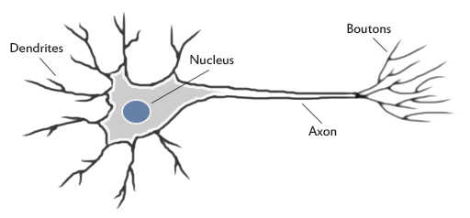
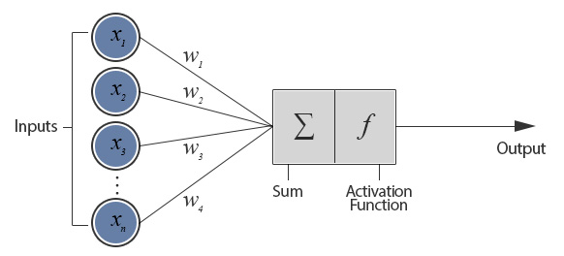
Biological Neuron Vs. Artificial Neuron

Slide 4
Why?
Ability to derive meaning from complicated or imprecise data
Can be used to extract patterns and detect trends that are too complex
Used in:
Adaptive Learning
Self Organization

Slide 5
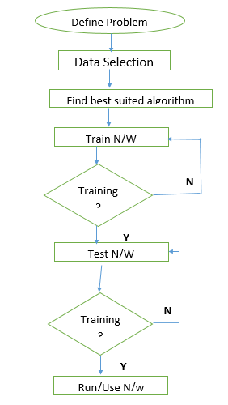
Working

